Slide 1
ENTOM 312 General Entomology
Mike Smith,
Professor of Entomology
785-532-4700
cmsmith@ksu.edu
128 Waters Hall
(Please see the syllabus for office hours.)

Slide 2
Why Should I Care About Insects ?
Course Objectives
Students will be able to…
Explain the importance of insects
Describe basic insect structure and function
Describe the basic classification of economically important insects
Explain how insects affect humans

Slide 3
Course Outcomes
At the end of the course, you should be able to…
Explain which order an insect belongs to
Describe something about an insect’s structure and function
Increase your insect appreciation and decrease your entomophobia (ento - insect, phobia - fear)
Not instinctively want to smash a bug!

Slide 4
^{Grading/Assessment}
Pop Tests (5 @ 10 points each) = 50 points, keep best 4 (40 pts.)
In-semester examinations* (3 @ 100 points each) - keep the best 2 scores (200 pts.)
Comprehensive final (mandatory) (100 pts.)
Group Report Presentations (60 pts.)
Grade Composition Grading Scale:
Pop tests 40 pts. 360 - 400 pts. - A
Exams 200 pts. 320 - 359 pts. - B
Final 100 pts. 280 - 319 pts. - C
Group Reports 60 pts. 240 - 279 pts. - D
Total Points 400 pts. 239 pts. & below - F
*Exams (multiple choice, true/false fill-in-the-blank, & short essay questions - based on coherent, complete sentences!). No make-ups, except for true medical emergencies, as explained & verified by physician’s letter.

Slide 5
What Do You Do to Succeed in the Course ?
1. Come to class. There will always be comments and discussion in class that will not be on the lecture files.
2. Study the class notes before AND after each class. Don’t wait to “react” to what’s presented. You’ll be behind from the start! Read about class lecture & discussion topics ahead of time. Do internet searches of information related to lectures. Read the newspaper. Be ready to ask questions and contribute to each class discussion.
3. DO NOT WAIT UNTIL THE DAY BEFORE AN EXAM TO STUDY !!! 100 years of educational data prove this is a blueprint for failure. Read, re-read, and highlite notes several times before each test.
4. No question is unimportant. Most likely, for every one you think is unimportant, there are several people with the same curiosity.
5. Read “entomocentrically”. Try to see the insect angle in news stories and science news you read.

Slide 6
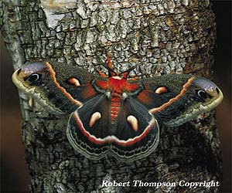
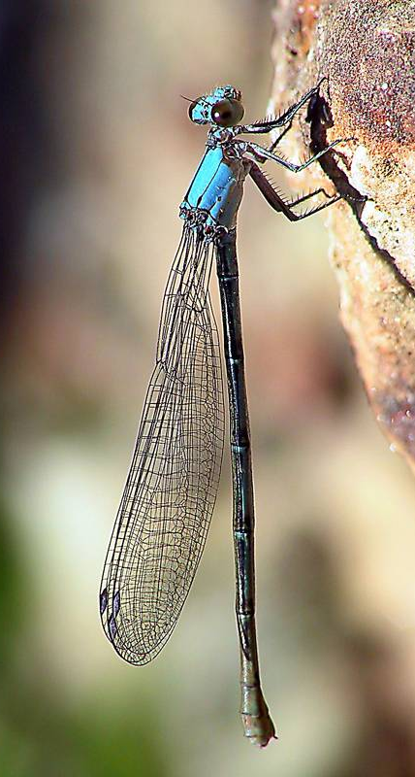
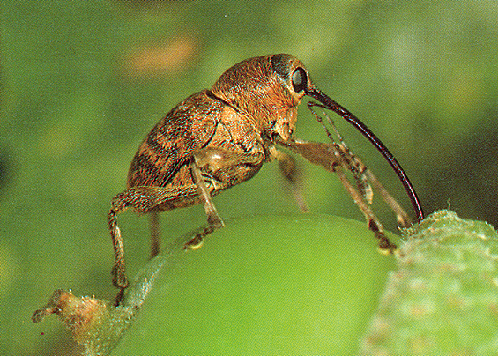
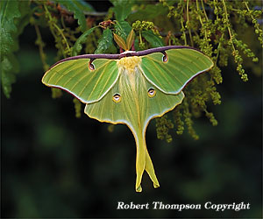
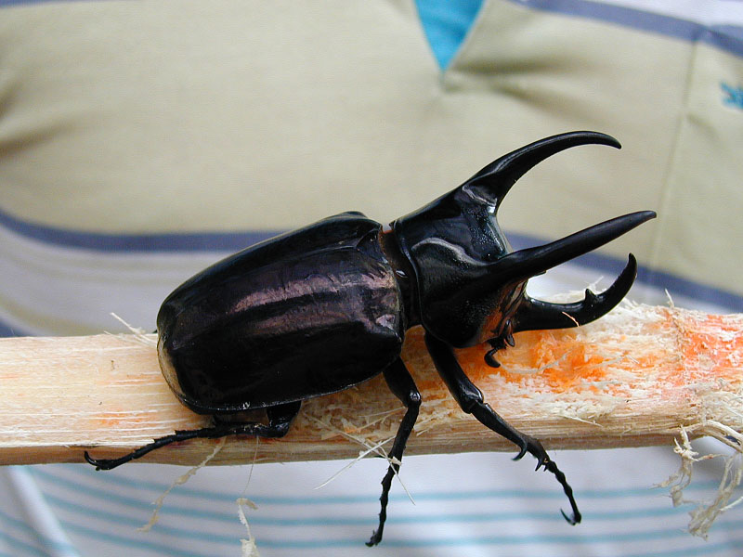
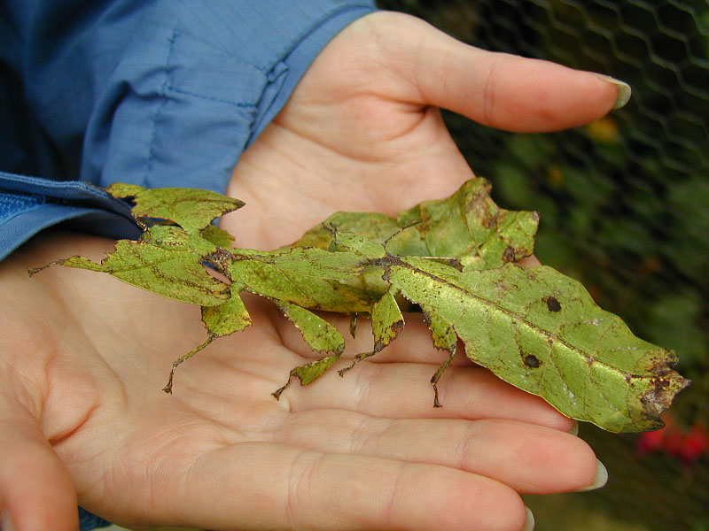
Why Study Insects?
There are ~ 10 quintillion (10,000,000,000,000,000,000) individual bugs on earth at any given moment !!
Insects outnumber humans ~200,000,000 to 1.
^{lbs/acre (U.S.)}
^{Insects 400}
^{Humans 14}

Slide 7
Butterflies & Moths - 160,000
^{Ants & Bees - 100,000}
^{Flies - 90,000}
^{Beetles - 350,000}
^{Worms}
^{Protoza}
^{Mammals- 6,000}
^{Fish}
^{Shells}
^{All Other Insects - 100,000}
^{Starfish}
^{Snails}
^{Other Arthropods}
1º = 3,000 species
~3/4 of all animals are Insects (~750,000 species)

Slide 8
Why Classify Organisms?
To study anything, we need a system of names - “nomenclature”
Similarity is the basis for all nomenclature & morphological traits were the first classifying traits.
Carl Linneaus (b. 1707, Sweden), created a system of animal & plant classification called binomial nomenclature: (bi = two; nome = names), i. e. the genus & the species
The species is the basic unit of nomenclature; the genus includes several species. ex. Blatella germanica or Blatella germanica

Slide 9
Taxonomic Category Hierarchy
Kingdom - Animalia
Phylum - Arthropoda
Class
Order
Family
Genus
Species
Keep Putting Coffee On For Good Students

Slide 10
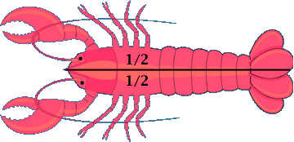
Phylum Arthropoda “jointed-feet”
Bilateral symmetry
An exoskeleton containing chitin
Segmented body: 20-21 ring-like metameres
Paired, jointed appendages
Dorsal heart with open circulation & dorsal brain
Ventral nerve cord & tracheal (air) system

Slide 11
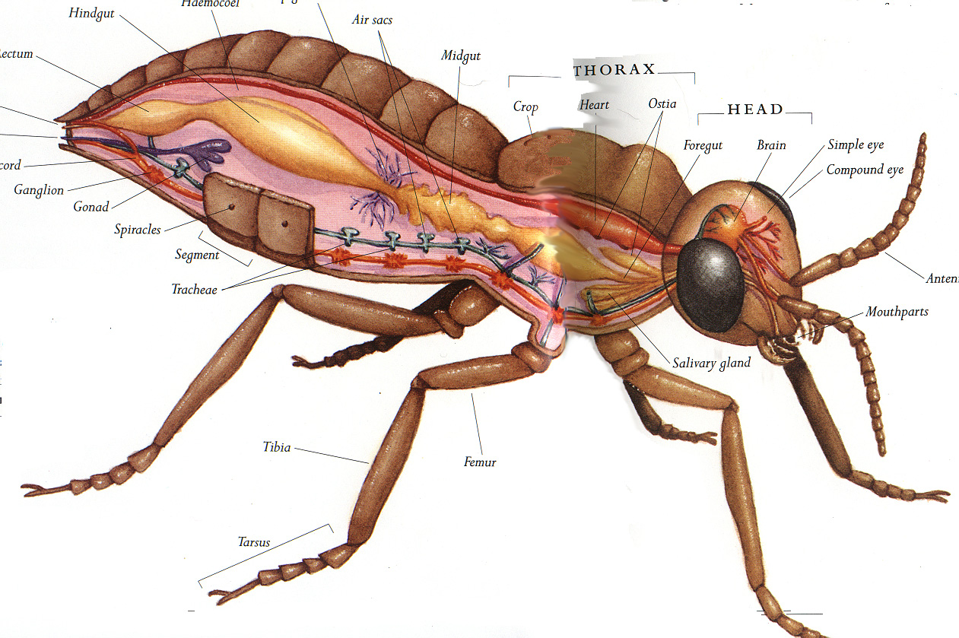
hindgut
Malphigian tubules
air sacs
^{Dorsal}
rectum
midgut
crop
heart
ostia
foregut
brain
ocellus
nerve cord
compound eye
ganglion
gonad
spiracles
segment
^{Ventral}
tracheae
antenna
mouthparts
salivary gland
tibia
femur
tarsus

Slide 12
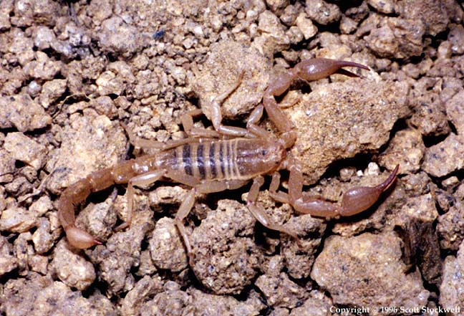
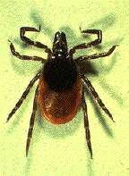
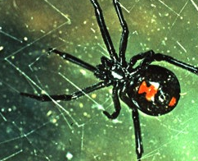
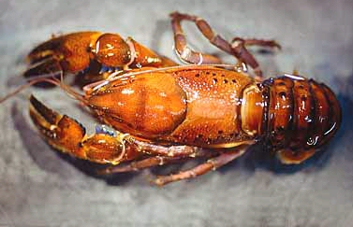
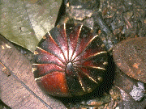
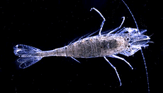
Arachnida (scorpions, ticks, spiders mites)
cephalothorax & abdomen; no antennae; 4 pairs of legs in adults; 1 pair mouthparts (chelicerae)
Crustacea
(barnacles, crabs, crayfish, lobsters, shrimp, pill bugs)
2 pairs of antennae, 5+ pairs of legs

Slide 13
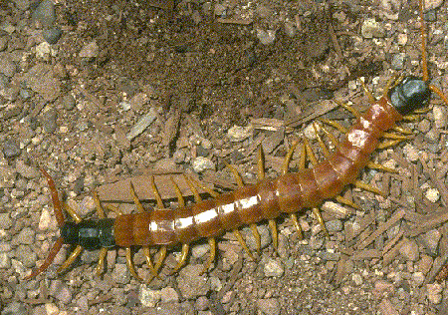
Chilopoda (centipedes)
wingless, multi-segmented trunk, each with 1 pr. legs (except 1st & last 2); 1 pr. antennae; first segment has poison legs (jaws) - “toxicognaths”
Diplopoda (millipedes)
wingless; 1 pr. antennae; multi-segmented trunk, each with 2 pr. legs (except 1st 3); segments fused dorsally; many spp. secrete chemical defense that may contain HCN
Jon Fouskaris

Slide 14
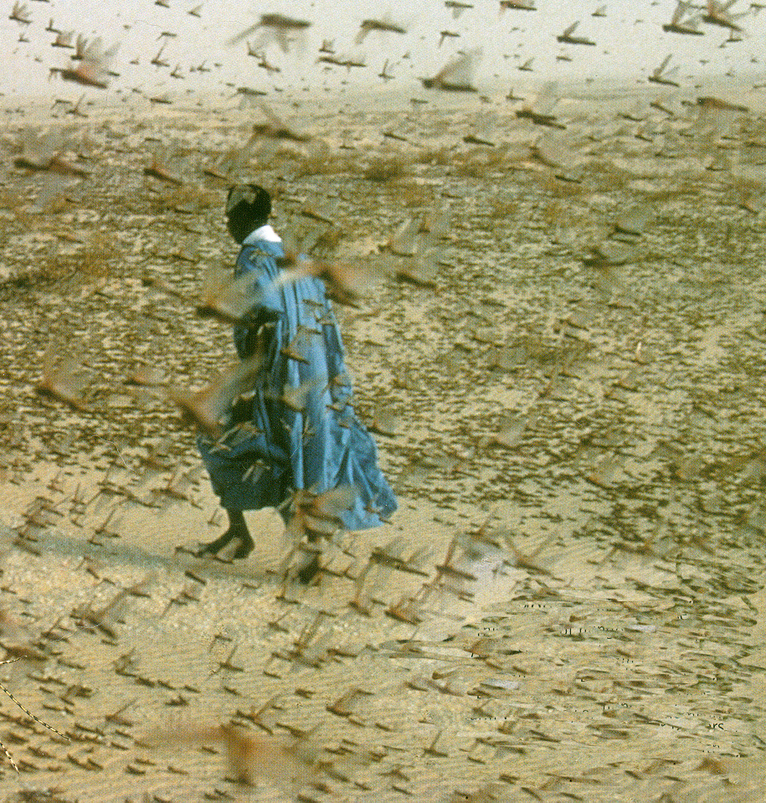
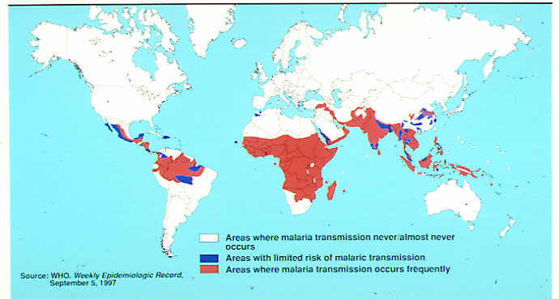
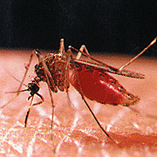
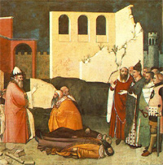
Negative Impacts– The Loss of Life, Food, and Homes
40% of all world food produced annually is lost to insects
Over 1 million people die each year of malaria, vectored by mosquitoes
Early bioterrorism/biowarfare - 1346, Tartar army hurled corpses of victims of flea-vectored plague over the walls of Kaffa in southern Russia.

Slide 15
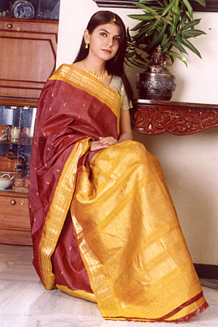
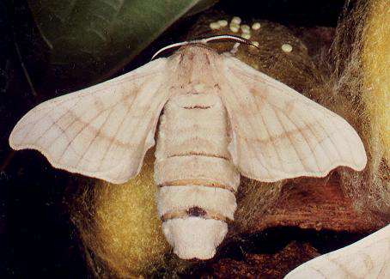
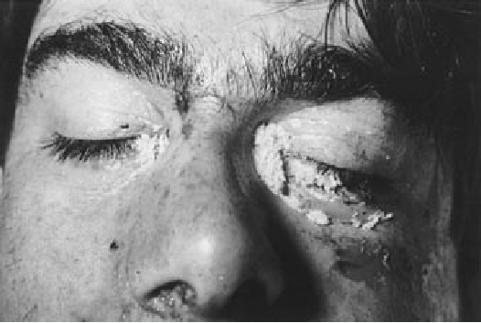
Positive Impacts - Food, Clothing, Medicine
Allantoin, secreted by maggots, discovered to heal deep wounds in World War I
~1/3 of the human diet is the direct result of insect pollination
Silk production in Asia & Europe
Scale insects used to make red dyes to color cosmetics, foods, & medicine.
Soil fertility from decomposers & burrowers; control of pests by predators and parasites (good bugs) -- ~$20 BILLION per yr. (+) to U.S. economy
Raw silk
Silk moth
Egg mass
Insects invading corpses are standard forensic tools used to make accurate estimates of the time and cause of death!

Slide 16
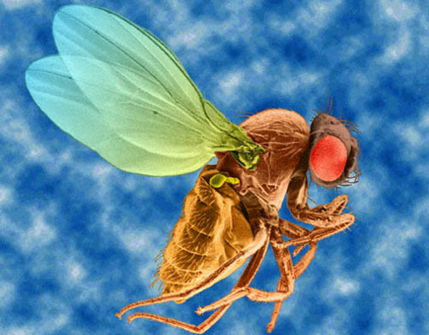
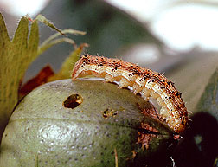
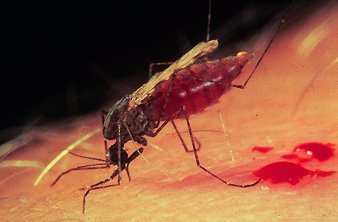
Summary
More insects than ALL other animals
combined
Crops: the good and the bad
Vectors of many diseases BUT provide useful products
Crime solving ability
Model organisms for research
Without insects, life as we know it would not be possible.

Slide 17
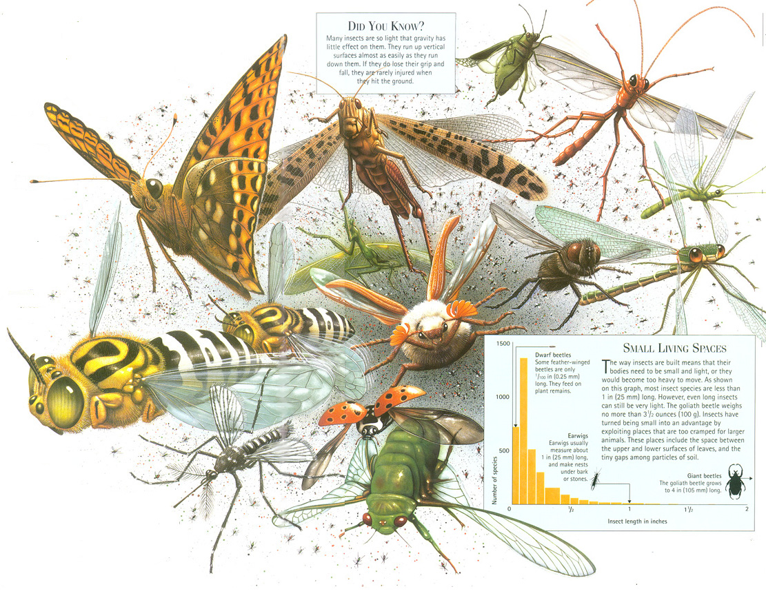
Many insect are so light that gravity has no effect on them. They run up vertical surfaces & if they lose their grip & fall, they are rarely injured when they hit the ground.
“Bugs are not going to inherit the earth. They own it now.
So we might as well make peace with the landlord”
Thomas Eisner

Slide 18
Conclusion
© Some of the imagery has been provided through Wiley-Blackwell™ with their permission. All course contents are copyrighted and should not be used for non-course-learning purposes.

